Slide 1
Introduction to Modeling Performance and Verification with Synthesizable MatchLib
Stuart Swan | Platform Architect
Siemens EDA, a part of Siemens Digital Industries Software

Slide 2

What is MatchLib?
MatchLib is a SystemC library of commonly used functions and components developed in partnership with NVIDIA
Interfaces, FIFOs, interconnect, etc.
Allows most design and verification of SoCs to be performed in SystemC
Verify system-level performance earlier
30x faster than RTL for timing-accurate simulation
Easily plugs into existing DV flows
Enables control-oriented design
Easy-to-use throughput accurate modelling
DMA, Arbiters, Bus I/F
Users
SystemC
Design
SystemC or System Verilog
Test Bench
MatchLib
*.h
Catapult
HLS
Performance Validation / Verification
RTL

Slide 3
MatchLib + HLS Enables an Efficient Verification Flow
MatchLib Involves DV Team at Every Stage of the Design Process
Early access to HW
Smaller, faster models
C++/SystemC model is typically about 1/10 or less than the size of the RTL model
Easy to verify and debug
C++/SystemC testbench reuse
Catapult makes it possible to automatically use same testbench for SystemC and Verilog models
You can put thin Verilog wrapper around SystemC DUT
If using SV UVM DV flow, enables SV DV effort to start much earlier (even before any HLS)
RTL, SystemC, or C++ with MatchLib wrapper
SystemC or System Verilog
Test Bench
DUT
SystemC or RTL Verification

Slide 4
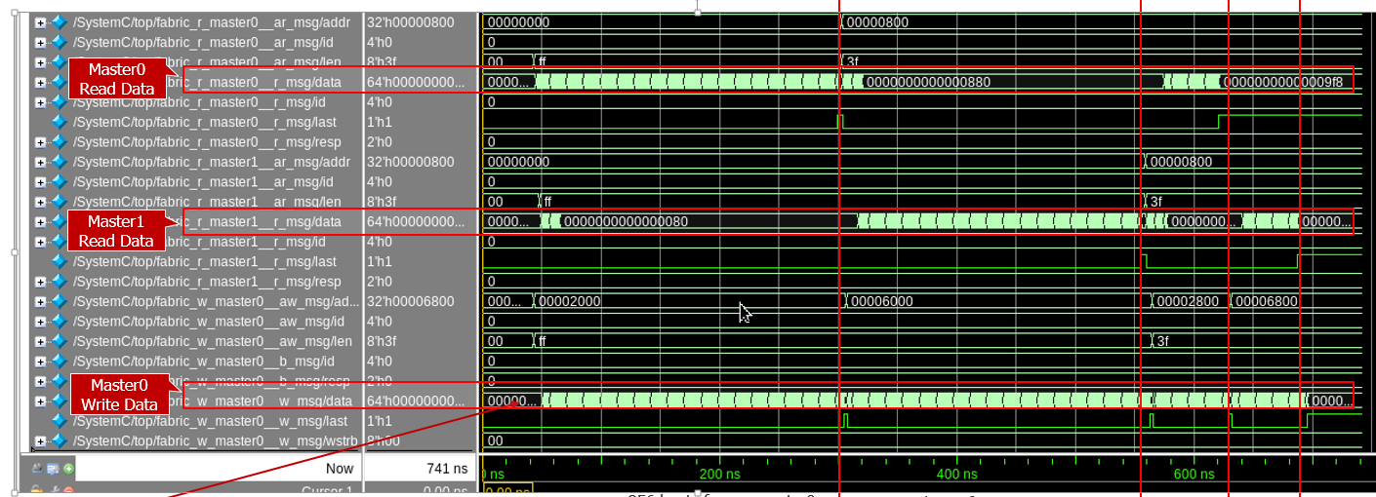
MatchLib Reduces Risks in Modern Digital Design
Today's HW designs often process huge sets of data, with large intermediate results.
Machine Learning, Computer Vision, 5G Wireless
Hard part is often managing the movement of data in the chip across all scenarios
Memory/interconnect architecture often has more impact on power/performance than the design of the computation units themselves
Evaluating and verifying memory/interconnect architecture at RTL level is often not feasible
Too late in design cycle
Too much work to evaluate multiple candidate architectures
The most difficult/costly HW (& HW/SW) problems are found during system integration
If integration first occurs in RTL, it is very late and problems are very costly
MatchLib + SystemC HLS lets integration occur early when fixing problems is much cheaper
MatchLib AXI4 Fabric
DMA0
AXI4 Router/
Splitter
AXI4
Arbiter
RAM0
CPU
AXI4 Router/
Splitter
DMA1
AXI4 Router/
Splitter
AXI4
Arbiter
RAM1
Bus contention
MatchLib AXI4 Fabric SystemC Simulation

Slide 5
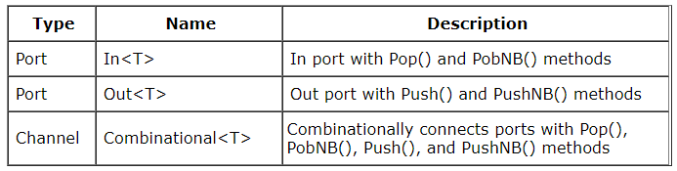
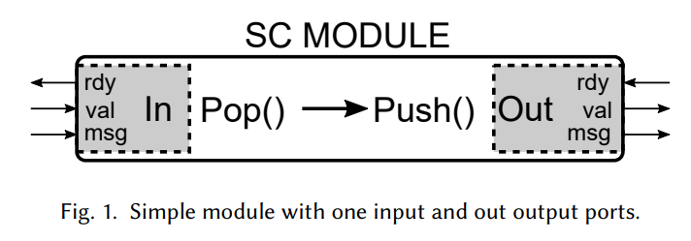
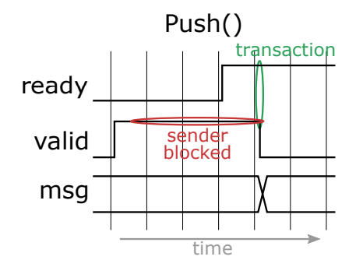
Using MatchLib Connections
MatchLib’s Connections is a library and API of latency-insensitive channels
All components of this library are synthesizable using HLS
Connections library consists of ports and channels
Port implements data/ready/valid protocol
Connections are templatized for data type T
rdy
rdy
val
val
dat
dat
rdy
val
dat

Slide 6
Using MatchLib Connections - Example
Connections inputs and outputs
#include <mc_connections.h>
class dut : public sc_module {
public:
sc_in<bool> CCS_INIT_S1(clk);
sc_in<bool> CCS_INIT_S1(rst_bar); Connections::Out<uint32> CCS_INIT_S1(out1);
Connections::In <uint32> CCS_INIT_S1(in1);
SC_CTOR(dut) {
SC_THREAD(main);
sensitive << clk.pos();
async_reset_signal_is(rst_bar, false);
}
private: void main() {
out1.Reset();
in1.Reset();
wait();
#pragma hls_pipeline_init_interval 1
#pragma pipeline_stall_mode flush
while (1) {
uint32_t t = in1.Pop();
out1.Push(t + 0x100);
}
}
};
Connections read
Connections write

Slide 7
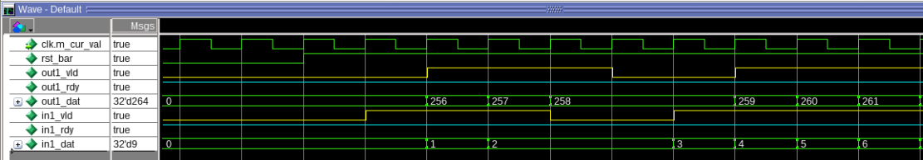
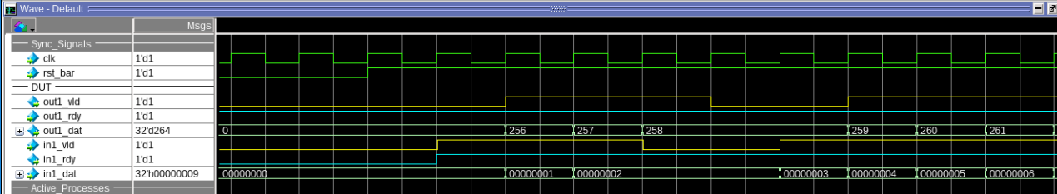
Simulating Performance Before Synthesis
Pre-HLS and Post-HLS simulation throughput are the same
There can be differences in latency
Pre-HLS Simulation
Post-HLS Simulation

Slide 8
Modelling Bus I/F With MatchLib
MatchLib provides high-quality implementations of AXI4 master and slave interfaces
Users can also model custom bus interfaces using MatchLib
This example models a simple read bus I/F with burst
Testbench models 2-cycle overhead for initiating a new burst
class dut : public sc_module {
public:
… void main() {
wait();
#pragma hls_pipeline_init_interval 1
#pragma pipeline_stall_mode flush
while (1) {
go.sync_in();
uint32 addr = addr_offset_csr.read();
uint32 burst_size = burst_csr.read();
read_addr_chan.Push(addr);
read_burst_size.Push(burst_size);
do {
uint32 data = read_data_chan.Pop();
read_data_out.Push(data);
} while (--burst_size !=0);
}
Initiate a burst by sending address and burst size
Read “burst_size” data from bus I/F

Slide 9
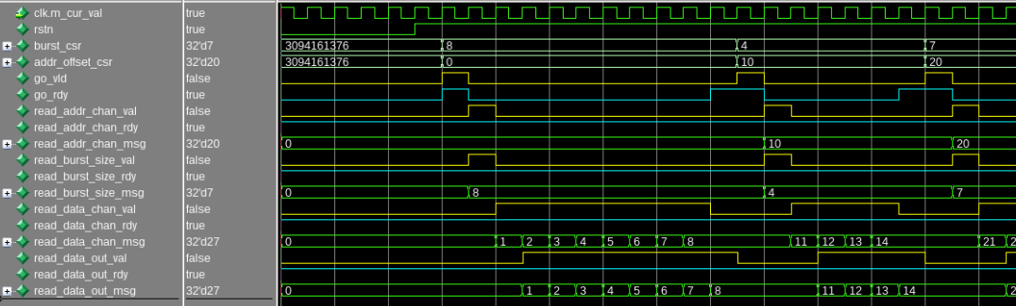
Modelling Bus I/F With MatchLib
Small burst size and/or non-consecutive addresses will hurt performance by injecting dead cycles
Pre-HLS Simulation
Burst runs with throughput==1
2-cycle overhead to start new burst
Initiate a burst by sending address and burst size

Slide 10
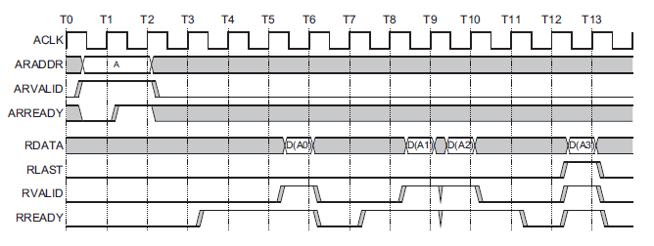
Complex Bus Protocols are Easily Modelled with MatchLib
AXI4 Master and Slaves are part of the MatchLib library
AXI4 segmenter transparently manages burst size, 4k boundaries, etc
AXI4 Read Master I/F with built-in segmentation
r_master<>
AXI4 Write Master I/F with built-in segmentation
w_master<>
AXI4 Slave I/F with built-in segmentation
slave<>
Interface reads/writes use connections Push/Pop methods
class bus_if: public sc_module
…
r_master<> r_master0;
…
while (1) {
…
r_payload r = r_master0.r.Pop();
…
}
…

Slide 11
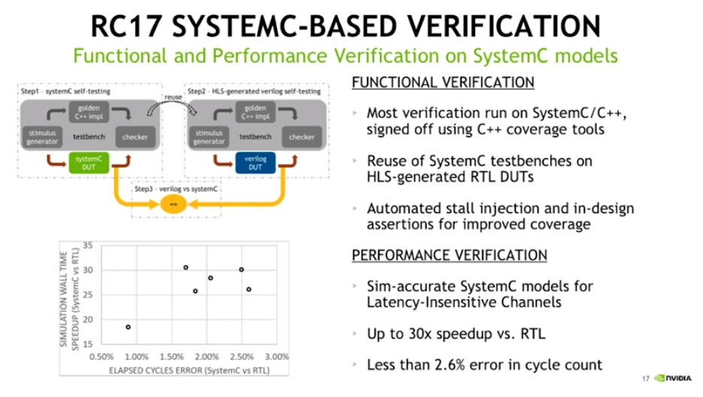
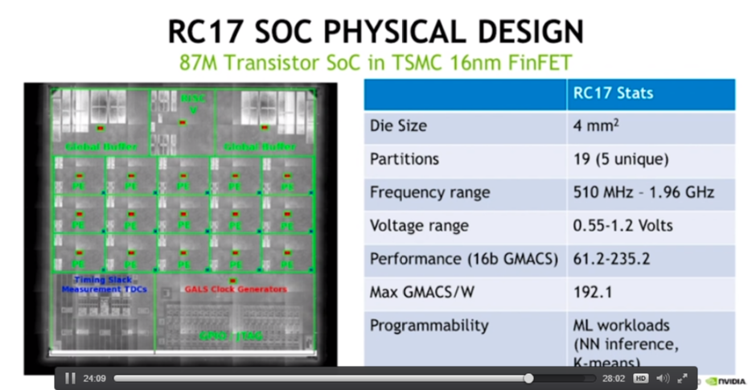
MatchLib and Catapult HLS Results
Notes:
Nvidia performed most verification at the SystemC level and simulation speed was 30 times faster than RTL
Nvidia has taped out multiple chips that were almost entirely designed with this flow.

Slide 12
Recap: MatchLib and Catapult HLS Enable Modern D/V Flow
Designer focuses on chip architecture, functionality, and throughput analysis/verification.​
HLS adds pipelining, optimizes microarchitecture, provides fully automated flow to placed gates.​
Focus of verification effort moves to C++/SystemC level, enabling much greater efficiency.​
Siemens Catapult HLS team is ready to help design teams adopt and succeed with MatchLib​
Fixes and enhancements to MatchLib source code​
Examples, assistance​
Notes:
Designer focuses on chip architecture, functionality, and throughput analysis/verification.
Focus of verification effort moves to C++/SystemC level, enabling much greater efficiency.
Mentor Catapult HLS team is ready to help design teams adopt and succeed with MatchLib

Slide 13
SystemC / Matchlib Resources in Catapult Release
Matchlib training slides
$MGC_HOME/shared/examples/matchlib/toolkit/doc/matchlib_customer_training.ppt
Matchlib example kit in Catapult install
$MGC_HOME/shared/examples/matchlib/toolkit

Slide 14
External Catapult SystemC / Matchlib Resources
Catapult SystemC MatchLib On-Demand Training (ODT)
https://eda.learn.sw.siemens.com/training/courses/catapult-high-level-synthesis-library
2021 Catapult Virtual Seminar (ML Accelerator using Matchlib):
https://event.on24.com/wcc/r/3187802/BF0CAE586A768CDB1314C956F64ABA35
Catapult Matchlib Webinars:
https://webinars.sw.siemens.com/how-matchlib-and-systemc-enables
https://webinars.sw.siemens.com/nvidia-design-and-verification-of-a-1
https://webinars.sw.siemens.com/early-axi-soc-performance
Youtube video from NVidia:
https://www.youtube.com/watch?v=n8_G-CaSSPU
Accellera SystemC Evolution Day 2020 Matchlib Presentation and Open Source Example Kit:
https://forums.accellera.org/files/category/2-systemc/

Slide 15
Thank you!

